Slide 1
Api Marketplace “Categorization”
1 | Description
2 | Terminologies
3 | Key Features
4 | Process Workflow
5 | Key Inputs/Outputs

Slide 2
Description

Slide 3
Descriptions
What is the API Marketplace?
Categorization is an AI-powered service provided by Drahim (an ARG Subsidiary).
It classifies merchants based on their business type and allows customers to modify or update classifications when required.
What is a Categorization?
Categorization Service: An AI-powered solution that classifies merchants into predefined business categories based on their business type and transaction data.
What The Categorization Does:
Automatically classifies merchants using AI.
Allows customers to update or modify classifications when needed.
How It Will Be Used (B2B):
Your business (Consumer) integrates with the API Marketplace to offer merchant categorization services to your customers through digital channels.
Advantages of Categorization (Business View):
Provide accurate merchant classification without building your own AI solution.
Unified and standardized access through the API Marketplace.
Faster time to market for subsidiaries by reusing a ready service.
Centralized monitoring, analytics, and security compliance.
How It Works (Business Flow):
Customers send merchant details → API Marketplace processes → Categorization result is returned.

Slide 4
Terminologies

Slide 5
Terminologies- Business Definitions
Merchant | A business entity that provides goods or services.
Categorization | Assigning merchants into predefined business categories (e.g., Food & Beverage, Electronics, Retail)
Merchant Category Code | Standardized 4-digit code used globally to classify merchants.
Consumer | Subsidiary using the service.
Customer | End user interacting with the categorization service.
1 9

Slide 6


Key Features – Business Perspective

Slide 7
Key Features
Automated classification of merchants using AI.
Ability for customers to modify or update classifications.
Unified access for all subsidiaries through the API Marketplace.
Strong security standards using OAuth2 + MTLS.Centralized audit logs and consolidated analytics.
Scalable and high-performing API (average 2–5 seconds response).

Slide 8
Process Workflow

Slide 9
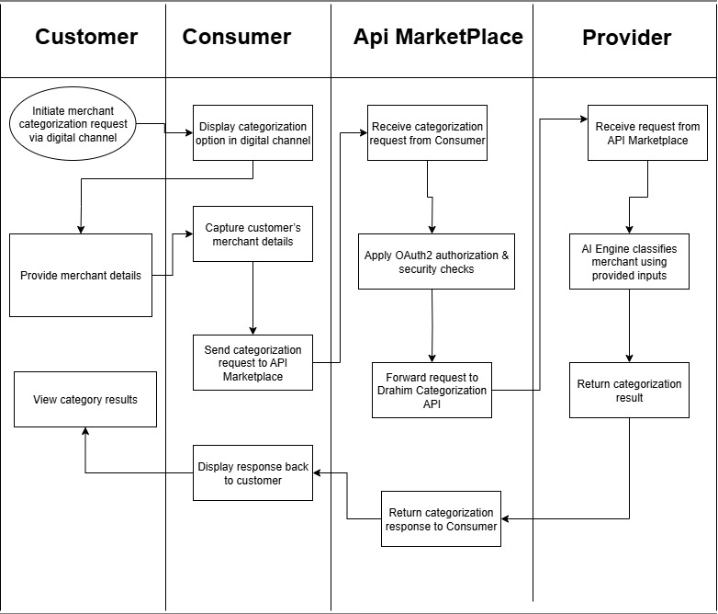

Slide 10
Inputs & Outputs – Business Keys

Slide 11
Purpose: Explain what the client needs to provide and what they will get from the APIs.
Inputs (Business Perspective):
Merchant Name(Mandatory)
MerchantID(Optional)
MerchantMccCode(Optional)
MerchantPaymentType(Optional)
Outputs (Business Perspective):
CategoryID, CategoryName
Verified Merchant details (Name, Logo, Description).
Confirmation of Classfication

